Slide 1
Electrophysiology Measurement and Stimulation System
Kyle Batzer, Richard Corsi, and Edward Crampton

Slide 2
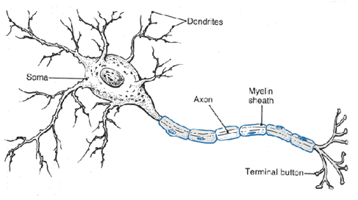
Biological Background
Neurons are cells that communicate using electrical pulses
Dendrites – “Inputs”
Axon – “Output”
Source: MindCreators

Slide 3
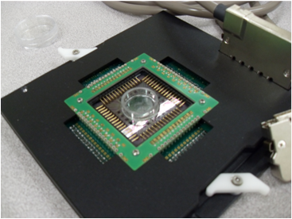
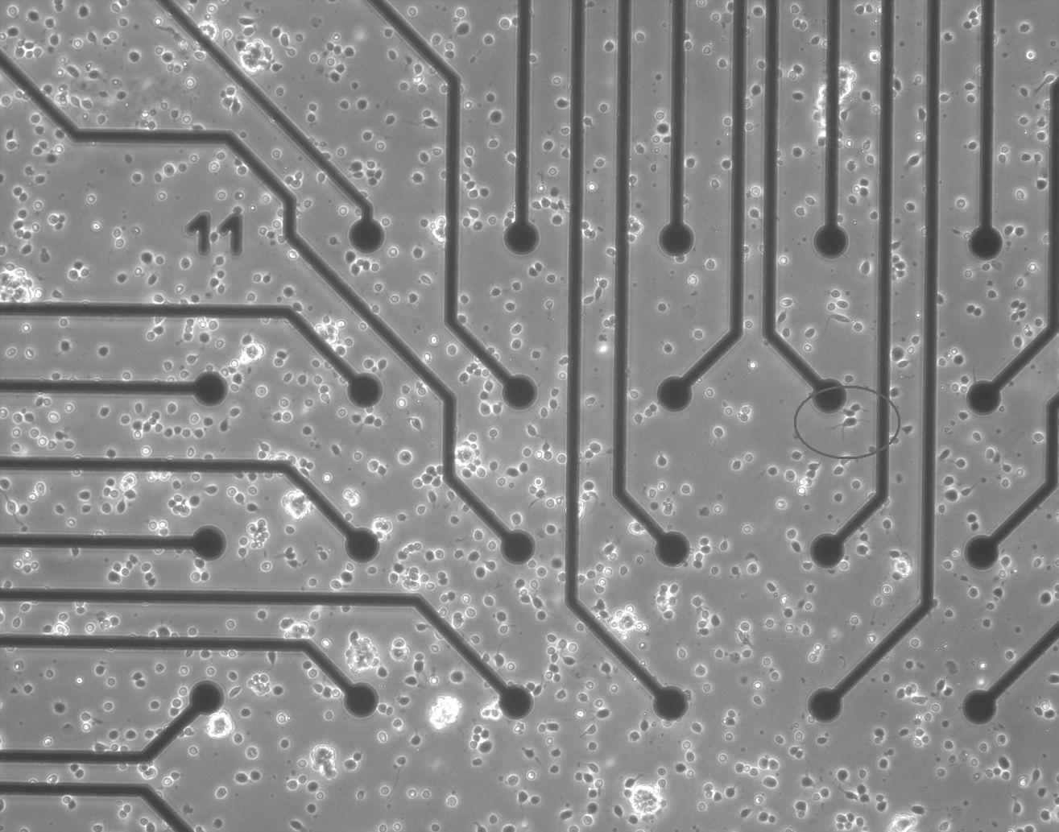
Micro-Electrode Array
Provides 60 channels for measurement and stimulation
Extracellular
Commercially available through Multi-Channel Systems
MEA and Fixture from Multi-Channel Systems
Cells on MEA

Slide 4
Project Need
Commercially available systems are expensive
Flexibility and relatively low cost
Current Configuration – Four Channels
Future support for up to 60 channels
Support Research at the Western Michigan University (WMU) Neurobiology Engineering Laboratory

Slide 5
Project Specifications
Full System Specifications
Default to Measurement Mode
User Selectable Mode (Measurement or Stimulation)
Support for 4 Channels, Expandable to 60
Analog Specifications
1000 V/V Gain from Electrode to High Pass Filter
20 Hz to 20kHz Passband
Must Use Low Noise Instrumentation Amplifier Based Circuit
Digital Specifications
Support External, User-Defined, and Real-Time Feedback Stimulation
Sampling Rate of 48 kSamples/channel
Record Measurement and Stimulation Continuously for 30 minutes

Slide 6
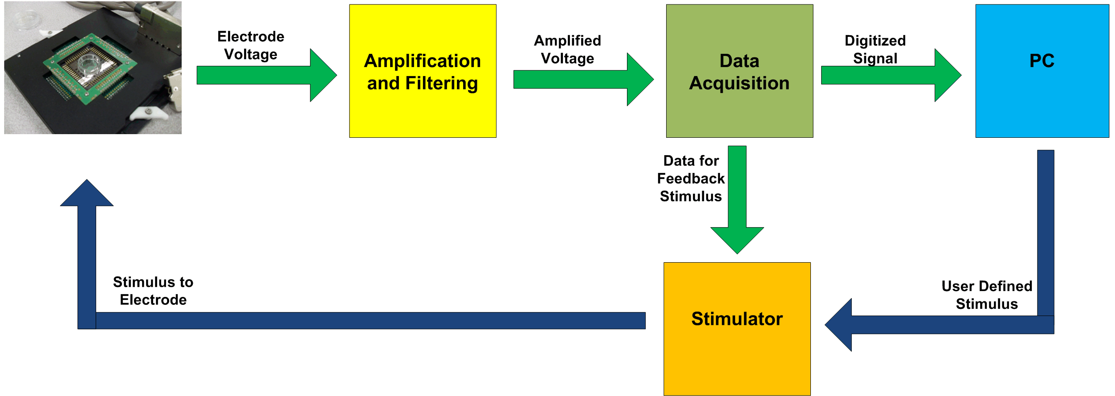
Project Overview

Slide 7
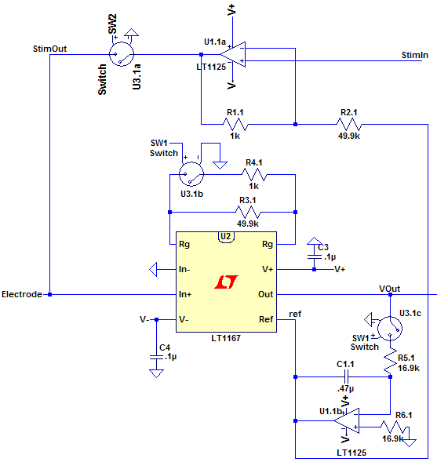
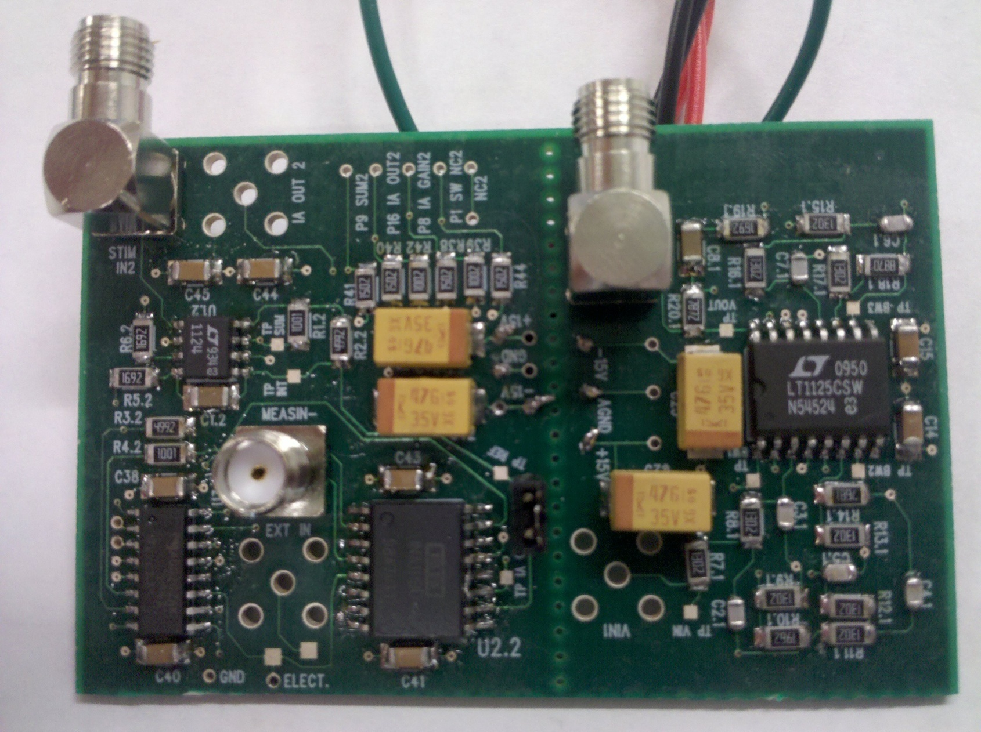
Analog Circuit Design
Switch Control/
Default Mode
Input / Output
Integrator/
Summing Circuit
Switches
IA
First Stage Amplification and Filter
First Stage PCB

Slide 8
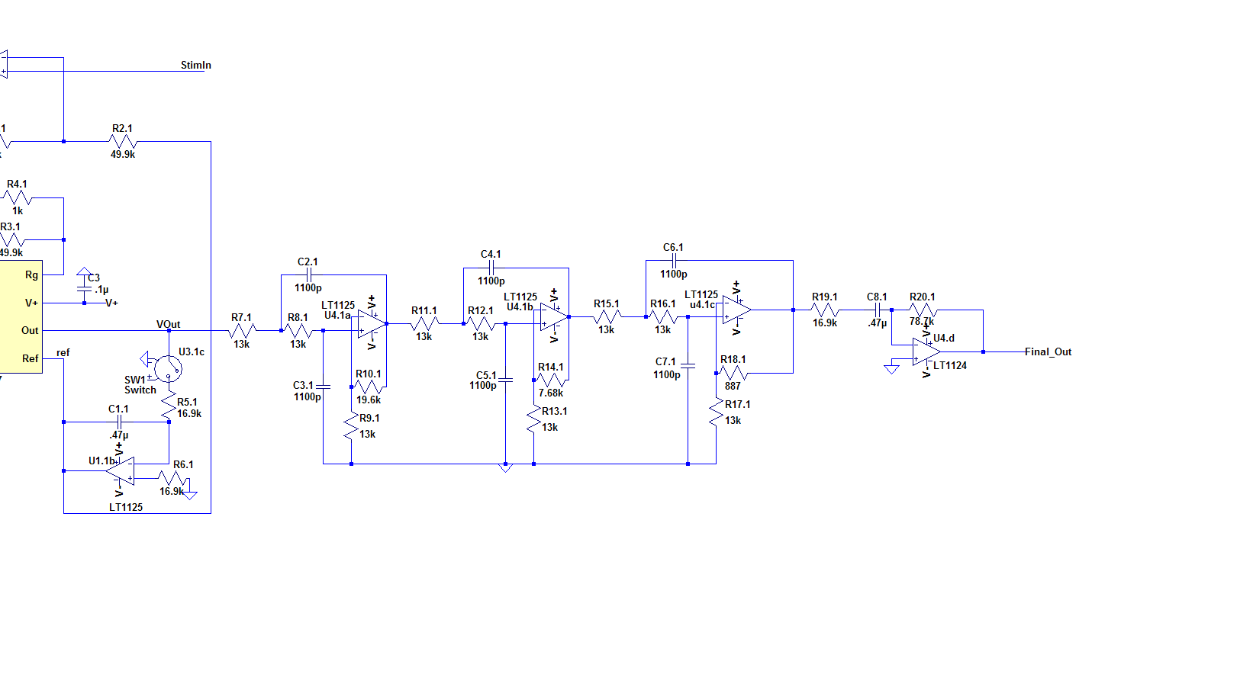

Analog Circuit Design cont’d
High Pass
Filter
Output
6th Order Low Pass Butterworth Filter
Input
High Pass Filter
Second Stage PCB

Slide 9
Calculated System Gain
Second Stage Amplification
First Stage Amplification
Butterworth Filter
High Pass
Filter
Instrumentation Amplifier
50
+
1
4.26
4.69
Electrode
1000V/V Gain
+
REF
-1 (RCs)
Z(s)

Slide 10
Measurement Results

Slide 11

Digital - Data Acquisition
Analog to Digital Converter – AD1871
Audio ADC – Supports two channels at 48 kSamples/Second
Spartan 3-E FPGA on a Nexys2 Development Board
Captures serial data from AD1871
Sends captured data to FT2232H in parallel
Parallel Fifo to USB – FTDI FT2232H
Data passed in parallel from FPGA is buffered and sent to PC through USB
Current Data Rate: 3 MB/Sec

Slide 12
Digital – PC Capture and Analysis
Data Capture Program
Uses D2XX API from FTDI to capture data
Packet Parser
Converts raw hex data to time offset and voltage
Ignores data with incorrect packet structure

Slide 13
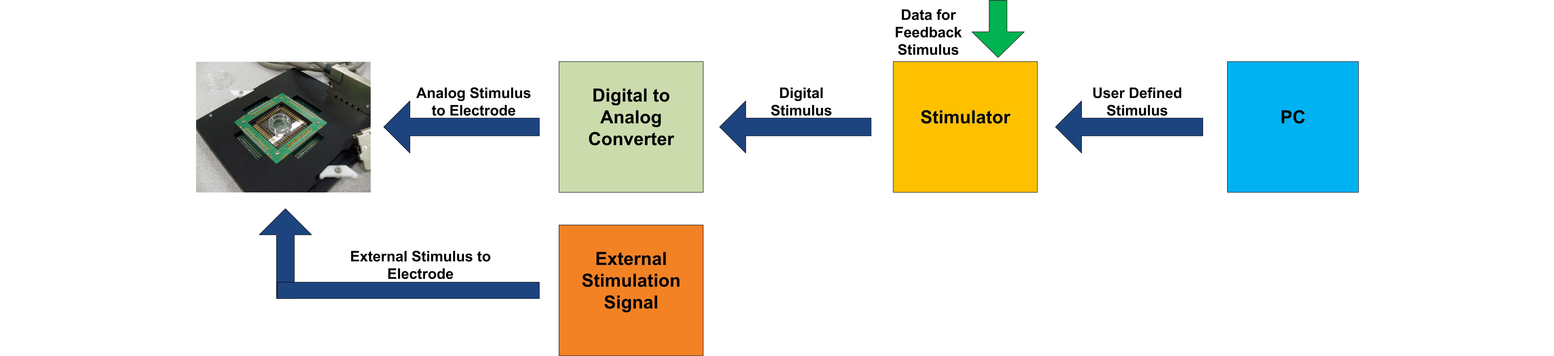
Digital - Stimulation
External Stimulation
Real-Time Stimulation
User Defined Stimulation

Slide 14
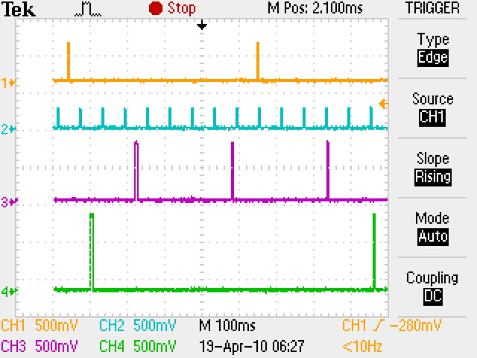
User Defined Stimulation

Slide 15
Overall System Performance

Slide 16

Specification Completion
100%
Full System Specifications
Default to Measurement Mode
User Selectable Mode (Measurement or Stimulation)
Support for 4 Channels, Expandable to 60
Analog Specifications
1000 V/V Gain from Electrode to High Pass Filter
20 Hz to 20kHz Passband
Must Use Low Noise Instrumentation Amplifier Based Circuit
Digital Specifications
Support External, User-Defined, and Real-Time Feedback Stimulation
Sampling rate of 48 kSamples/channel
Record Measurement and Stimulation Continuously for 30 minutes
100%
89%
66%

Slide 17
Future System Improvements
Packet Error Rate
Software Control
Implement Real-Time Feedback
Enclosure for Amplification/Filter Circuit
Expand Number of Channels Supported
Internal Power Supply

Slide 18
Summary

Slide 19
Acknowledgements
Drs. Damon Miller, Frank Severence, and Bradley Bazuin
Ph.D. students Mike Ellinger and John Stahl
Siebert WMU Undergraduate Research and Creative Activities Award Program
Michigan Space Grant Consortia
Sunstone Circuits

Slide 20
References
[1] Y. Jimbo, N. Kasai, K. Torimitsu , T. Tateno, and H. P.C. Robinson, “A system for MEA-based multisite stimulation,” IEEE Transactions on Biomedical Engineering, vol. 50, no. 2, pp. 241-248, Feb 2003.
[2] M. Ellinger, “Acquisition and Analysis of Biological Neural Network Action Potential Sequences,” WMU Master of Science in Electrical Engineering, June 2009.
[3] T. Caruso, E. Daiek, and E. Jones, “Low Noise Amplification and Stimulation System for Neural Multi-Electrode Arrays,” WMU Department of Electrical and Computer Engineering Senior Design Project, December 2009.
[4] J. Stahl, “Dual Channel Low Noise Amplifier for Experiments in Neurophysiology,” WMU Master of Science in Electrical Engineering, June 2009.

Slide 21
QUESTIONS?

